Slide 1
Linear Inequalities
Shreyas M
B.Tech in ECE PES University Bangalore

Slide 2
Chapter map
Section | Topic
1 | Introduction
2 | Intervals
3 | Mono-Variate Linear Inequation
4 | System of Mono-Variate Linear Inequation
5 | Bi-Variate Linear Inequations
6 | System of Bi-Variate Linear Inequations

Slide 3
1 Introduction
Like Linear Equations, Linear inequations are also Mathematical statements that operate on the variables of Power 1
In equations the condition to be satisfied is equality. In inequalities, we check the RANGE of values that a variable can take so that given condition is satisfied
The concept of linear inequations comes in very handy in Engineering when we need to decide optimal (or permissible) range of values that can be chosen for parameters of systems to obtain a particular desired response.

Slide 4
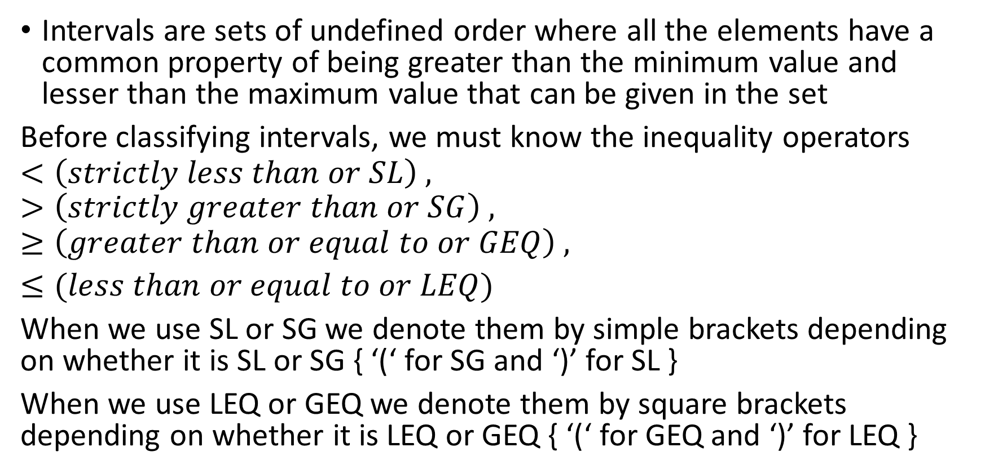
2 Intervals
Intervals are sets of undefined order where all the elements have a common property of being greater than the minimum value and lesser than the maximum value that can be given in the set
Before classifying intervals, we must know the inequality operators
$$<\left(strictly less than or SL\right) ,$$
$$>\left(strictly greater than or SG\right) , ≥\left(greater than or equal to or GEQ\right) ,$$
$≤(less than or equal to or LEQ)$
When we use SL or SG we denote them by simple brackets depending on whether it is SL or SG { ‘(‘ for SG and ‘)’ for SL }
When we use LEQ or GEQ we denote them by square brackets depending on whether it is LEQ or GEQ { ‘(‘ for GEQ and ‘)’ for LEQ }

Slide 5
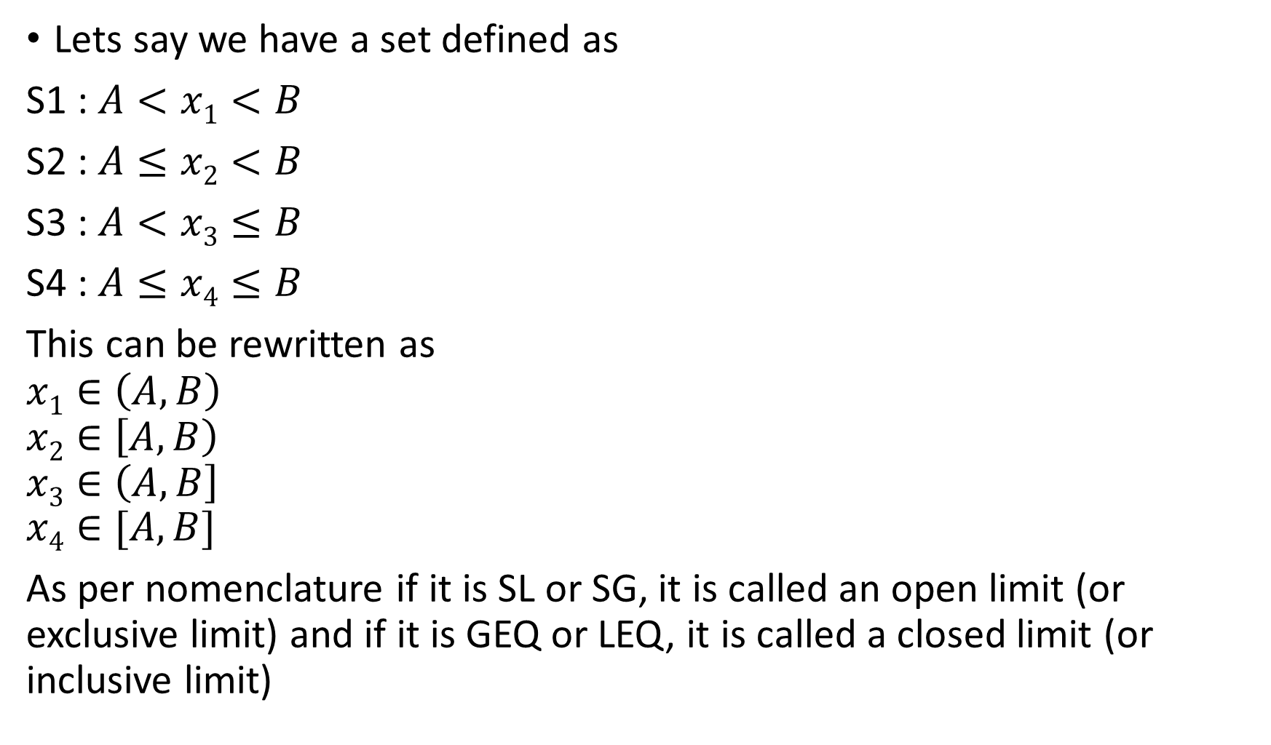
Lets say we have a set defined as
S1 : $A<x1<B$
S2 : $A≤x2<B$
S3 : $A<x3≤B$
S4 : $A≤x4≤B$
This can be rewritten as
$$x1∈\left(A,B\right)$$
$$x2∈\left[A,B\right)$$
$$x3∈\left(A,B\right]$$
$$x4∈[A,B]$$
As per nomenclature if it is SL or SG, it is called an open limit (or exclusive limit) and if it is GEQ or LEQ, it is called a closed limit (or inclusive limit)

Slide 6
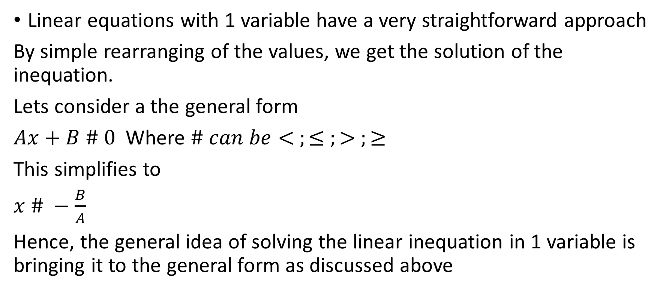
3 Mono-Variate Linear Inequation
Linear equations with 1 variable have a very straightforward approach
By simple rearranging of the values, we get the solution of the inequation.
Lets consider a the general form
$Ax+B \# 0$ Where $\# can be< ;≤ ;> ;≥$
This simplifies to
$x \# −\frac{B}{A}$
Hence, the general idea of solving the linear inequation in 1 variable is bringing it to the general form as discussed above

Slide 7
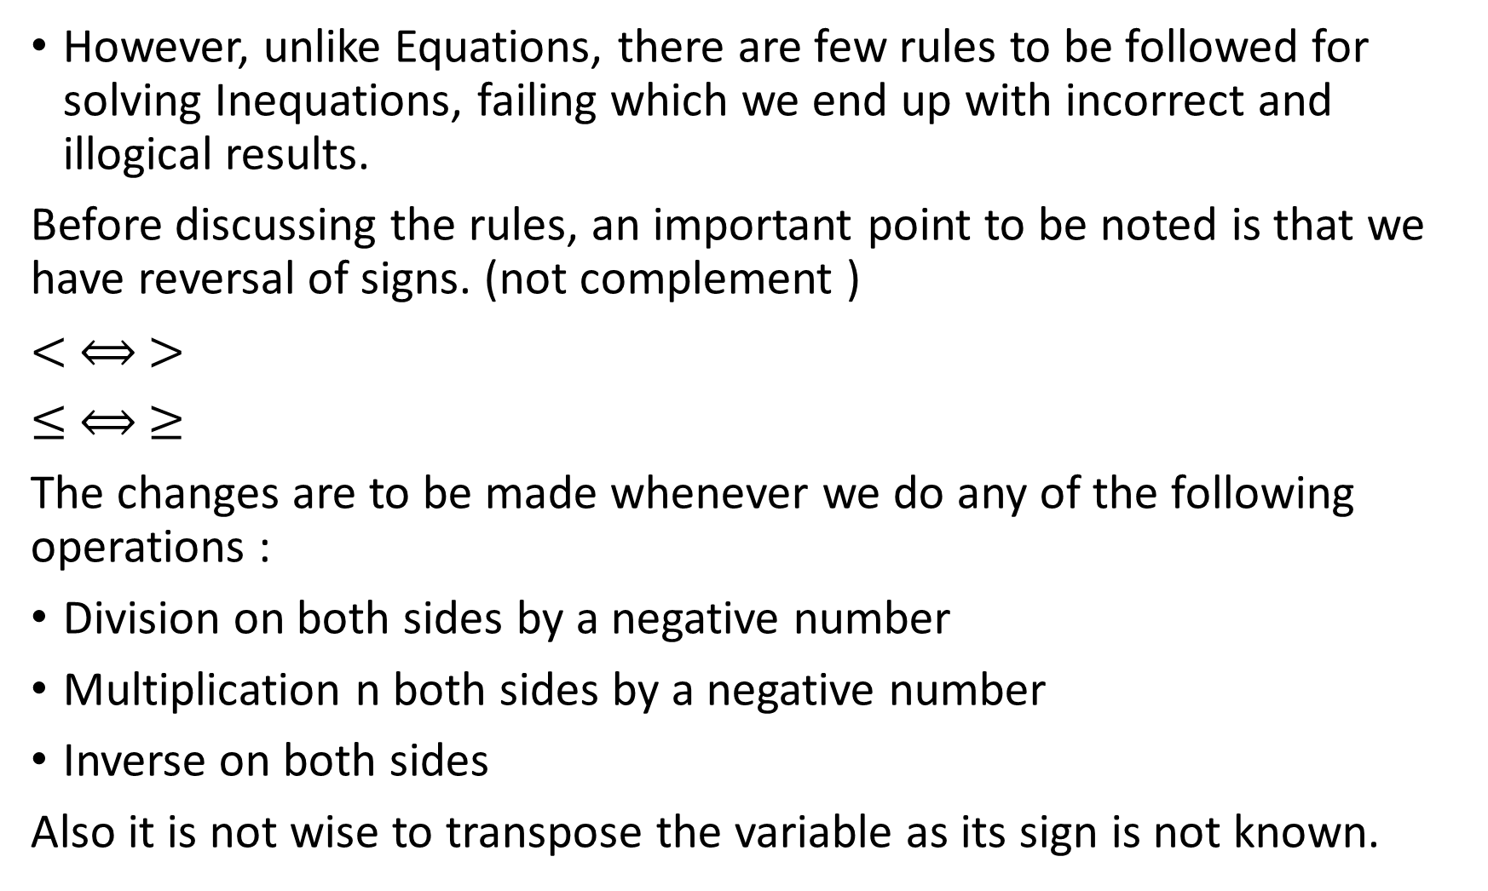
However, unlike Equations, there are few rules to be followed for solving Inequations, failing which we end up with incorrect and illogical results.
Before discussing the rules, an important point to be noted is that we have reversal of signs. (not complement )
$< ⟺ >$
$≤ ⟺ ≥$
The changes are to be made whenever we do any of the following operations :
Division on both sides by a negative number
Multiplication n both sides by a negative number
Inverse on both sides
Also it is not wise to transpose the variable as its sign is not known.

Slide 8
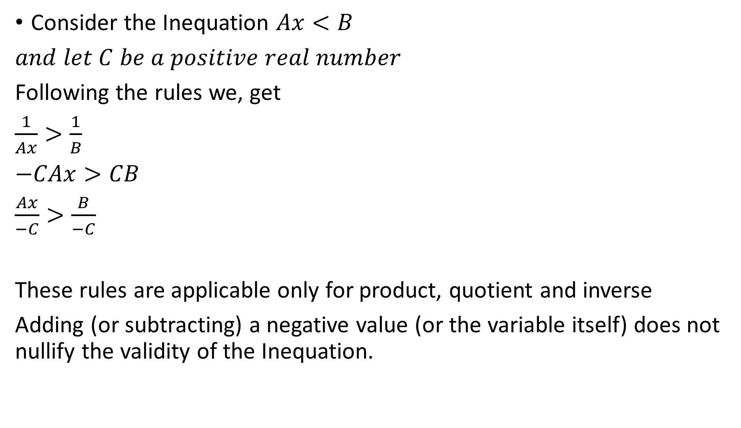
Consider the Inequation $Ax<B$
$and let C be a positive real number$
Following the rules we, get
$\frac{1}{Ax}>\frac{1}{B}$
$−CAx>CB$
$\frac{Ax}{−C}>\frac{B}{−C}$
These rules are applicable only for product, quotient and inverse
Adding (or subtracting) a negative value (or the variable itself) does not nullify the validity of the Inequation.

Slide 9
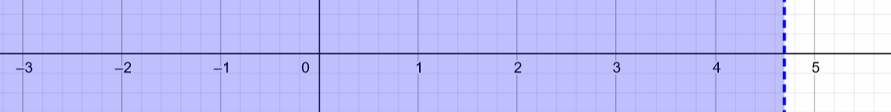
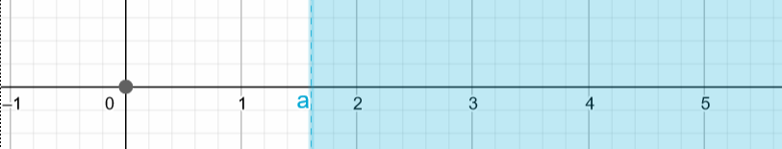
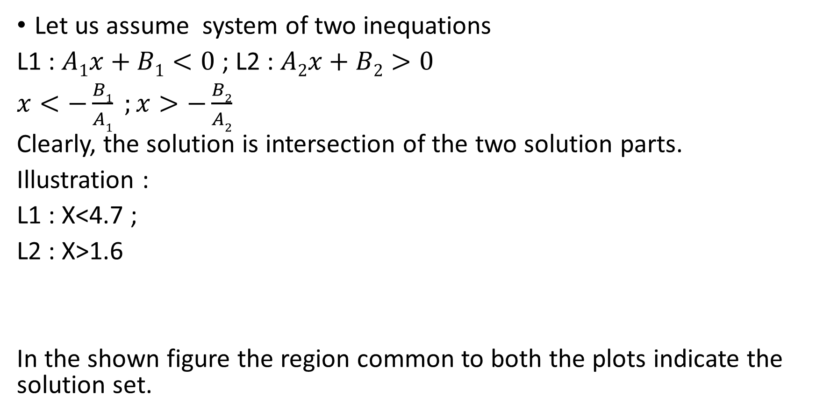
4 System of Mono-Variate Linear Inequation
Let us assume system of two inequations
L1 : $A1x+B1<0$ ; L2 : $A2x+B2>0$
$x<−\frac{B1}{A1} ;x>−\frac{B2}{A2}$
Clearly, the solution is intersection of the two solution parts.
Illustration :
L1 : X<4.7 ;
L2 : X>1.6
In the shown figure the region common to both the plots indicate the solution set.
L1 : X<4.7
L2: X>1.6

Slide 10
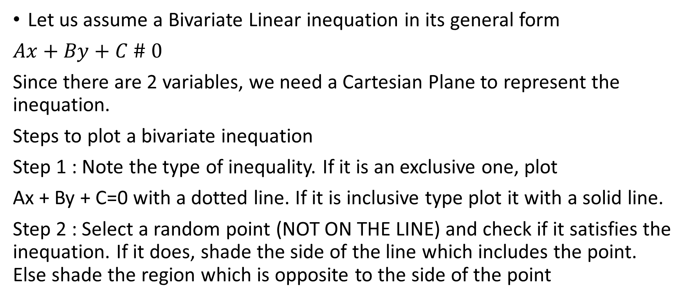
5 Bi-Variate Linear Inequations
Let us assume a Bivariate Linear inequation in its general form
$Ax+By+C \# 0$
Since there are 2 variables, we need a Cartesian Plane to represent the inequation.
Steps to plot a bivariate inequation
Step 1 : Note the type of inequality. If it is an exclusive one, plot
Ax + By + C=0 with a dotted line. If it is inclusive type plot it with a solid line.
Step 2 : Select a random point (NOT ON THE LINE) and check if it satisfies the inequation. If it does, shade the side of the line which includes the point. Else shade the region which is opposite to the side of the point

Slide 11
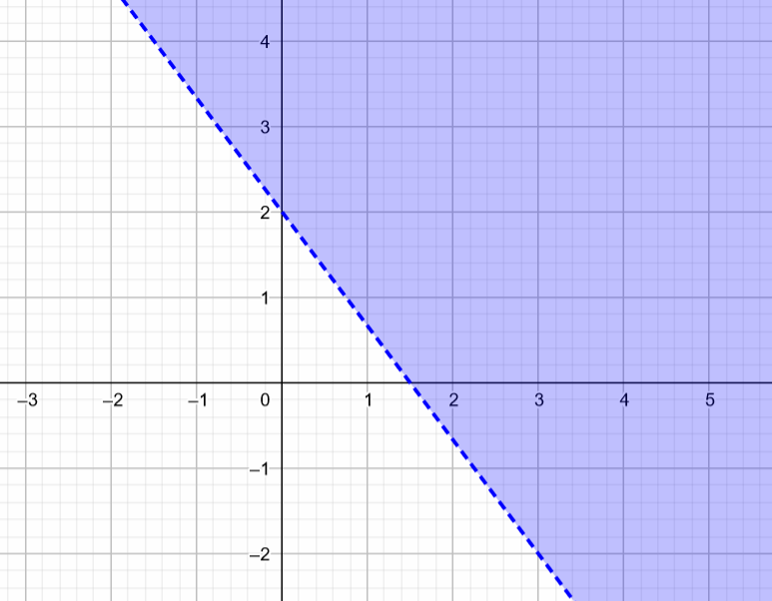
Illustration : Let us plot for 4x+3y>6
Step 1 : since it is an exclusive type, we plot 3x+4y-6=0 with a dashed
(or dotted) line
Step 2 : Let x=y=0 . 3(0) +4(0) > 6 is a false statement. Therefore we shade the region opposite to the side that contains (0,0).

Slide 12
6 System of Bi-Variate Linear Inequations
With the knowledge of procedure to plot a bivariate Linear Inequation, Solving a system of bivariate Linear Inequations gets simple
Procedure :
Step 1 : Plot the first equation along with the appropriate Shading
Step 2 : Plot the second equation along with the appropriate Shading
Step 3 : Obtaining the solution : check the commonly shaded region and identify the range of the variables. This gives the solution set of the bivariate linear inequations

Slide 13
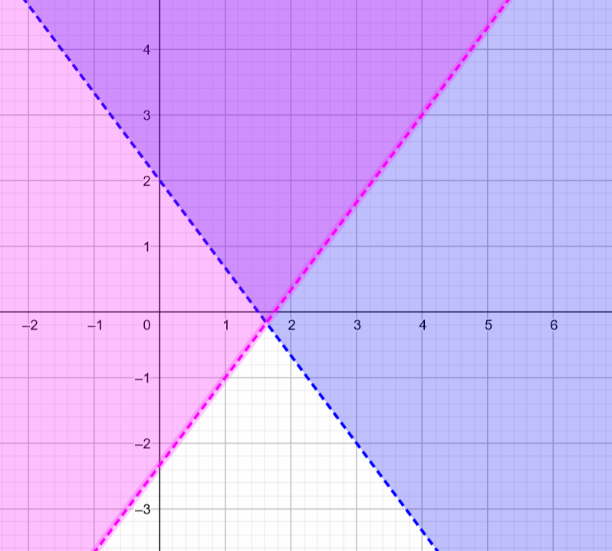
Illustration :
4x + 3y > 6
4x - 3y < 7

Slide 14
Thank you
Shreyas M
B.Tech in ECE PES University Bangalore

